Slide 1
Checking MPESA transactions

Slide 2
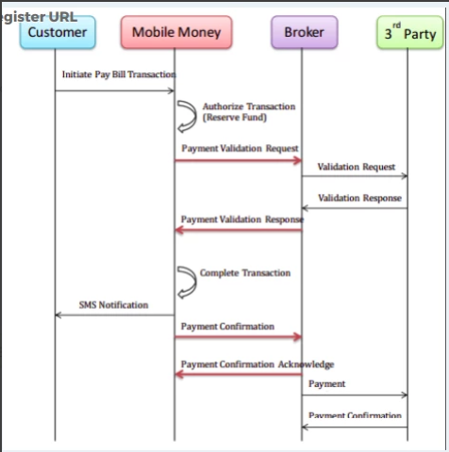
Context
The Safaricom C2B API is unreliable such that their responses for a successful transaction are not received or not received in the right order.
We have already re-architected to accept either their ‘confirmation’ or ‘validation’ response.
However in some scenarios we don’t receive either response at all. As our volumes grow the need for a semi-automated solution is required.
Typically Finance who can check transactions aren’t available at certain times and this results in a manual top up which may delay a customer from buying fuel.
We need to enable Customer Support to be able to check the transaction and then credit the customer while they are at the KP.

Slide 3
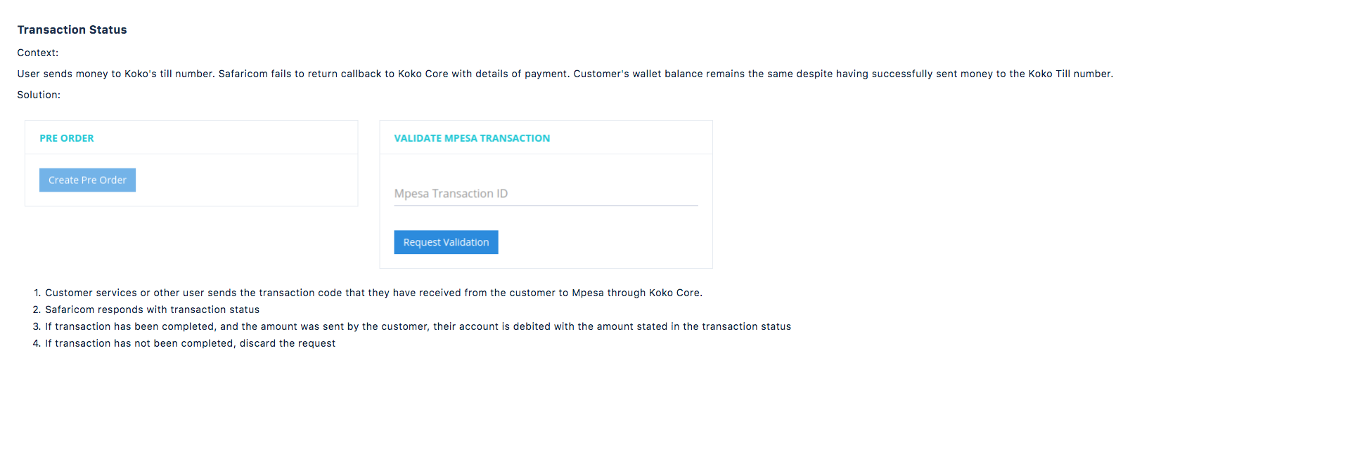
Solution

Slide 4
Responses
Successful top up
Failure to find the transaction
Failure of top up
Other error
Need to define the responses that appear for the user in KOKO Core.

Slide 5
Work required
An outline solution was done as part of a POC by Ethan in August.
It wasn’t complete as he was experiencing issues testing the Safaricom query API.
We need resource to support the completion of this work, with an aim to get this out in R26.
1- 2 weeks:
Server side engineer
QA engineer
Ideally Nairobi because of testing Safaricom API

Slide 6
Invalid Kit ID
Placeholder

Slide 7
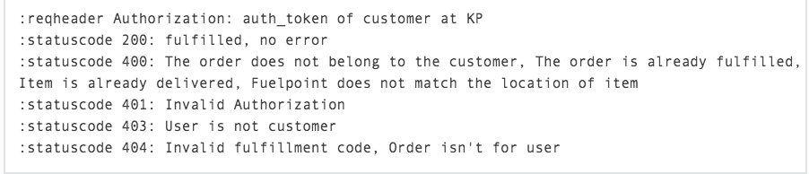
Better handling for fulfilment failures
Cause of Invalid Kit ID error
Kits not in KNK Kit Tracker
Incorrect Shop ID assigned to KOKOpoints
Kits moved physically from delivered shop to another
Hyphenated Kit Serial Numbers (Encoded in the QR Code)
Safaricom (B2C) Referral Code Failure
Incorrect Entry of Kit Serial Number at shop
KOKO Core Fulfillment API issues
KOKO Core Sales Order not in Odoo
API response - not all are handled in KP
All the above errors are showing up on KP as ‘Invalid Kit ID’. As a result all the issues come to software for resolution because CS and Stoves can’t troubleshoot. Then we spend time analysing the root cause before finding someone to make the fix, either in our team, @Saarus or in the Stoves team. Better handling of these in the KP would reduce time to solve and fix.
N.B. Combination of server side and android changes.

Slide 8
Making fulfilment asynchronous
Placeholder
Potentially can be bundled with invalid kit ID as related.

